Slide 1
Website classification
Submitted by Nilakrishna M

Slide 2
Website classification
Aim : The project consisted to evaluate different classification models to predict malicious and benign websites, based on application layer and network characteristics.
Dataset : Kaggle
Tool used : R
ML problem : Binary classification
Models : Logistic regression, Decision tree, Random forest
Evaluation metric : Accuracy

Slide 3
Features:
NUMBERSPECIALCHARACTERS: it is number of special characters identified in the URL, such as, “/”, “%”, “#”, “&”, “. “, “=”
CHARSET: it is a categorical value and its meaning is the character encoding standard (also called character set).
SERVER: it is a categorical value and its meaning is the operative system of the server got from the packet response.
CONTENT_LENGTH: it represents the content size of the HTTP header.
WHOIS_COUNTRY: it is a categorical variable, its values are the countries we got from the server response (specifically, our script used the API of Whois).
WHOIS_STATEPRO: it is a categorical variable, its values are the states we got from the server response (specifically, our script used the API of Whois).
WHOIS_REGDATE: Whois provides the server registration date, so, this variable has date values with format DD/MM/YYY HH:MM
WHOISUPDATEDDATE: Through the Whois we got the last update date from the server analyzed
TCPCONVERSATIONEXCHANGE: This variable is the number of TCP packets exchanged between the server and our honeypot client
DISTREMOTETCP_PORT: it is the number of the ports detected and different to TCP
REMOTE_IPS: this variable has the total number of IPs connected to the honeypot
APP_BYTES: this is the number of bytes transferred
SOURCEAPPPACKETS: packets sent from the honeypot to the server
REMOTEAPPPACKETS: packets received from the server
APP_PACKETS: this is the total number of IP packets generated during the communication between the honeypot and the server
DNSQUERYTIMES: this is the number of DNS packets generated during the communication between the honeypot and the server
Target variable:
TYPE: this is a categorical variable, its values represent the type of web page analyzed, specifically, 1 is for malicious websites and 0 is for benign websites

Slide 4
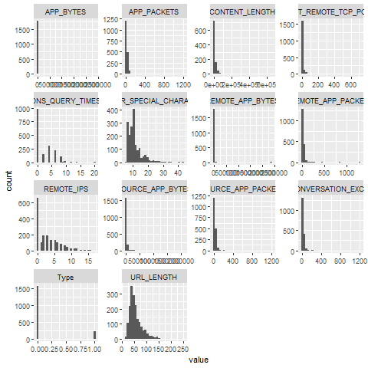
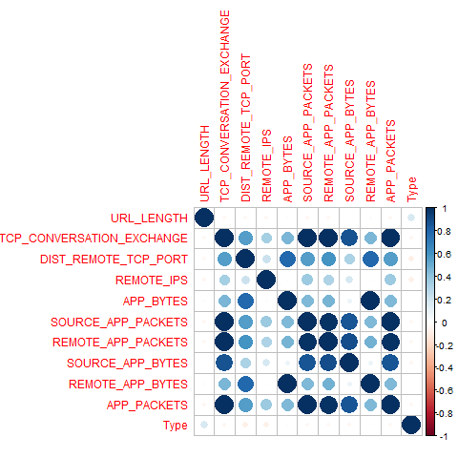
Histogram Correlation plot

Slide 5
Data Preprocessing
Removed features that are not essential for our model.
The Variables chosen for model building are:
URL_LENGTH TCP_CONVERSATION_EXCHANGE , DIST_REMOTE_TCP_PORT ,REMOTE_IPS,APP_BYTES SOURCE_APP_PACKETS , REMOTE_APP_PACKETS , SOURCE_APP_BYTES ,REMOTE_APP_BYTES , APP_PACKETS,TYPE
Missing values : There are no missing values
Dataset is divided into test and train dataset with split ratio as 0.8

Slide 6
Models
Logistic Regression
Confusion matrix
PredictedValue
ActualValue FALSE TRUE
0 413 16
1 35 21
Accuracy : 0.8948454

Slide 7
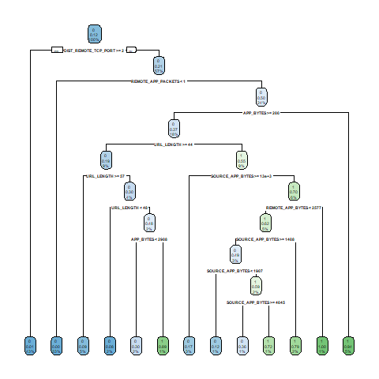
Decision Tree
Confusion matrix
PredictedValue
ActualValue 0 1
0 416 13
1 19 37
Accuracy : 0.9340206

Slide 8
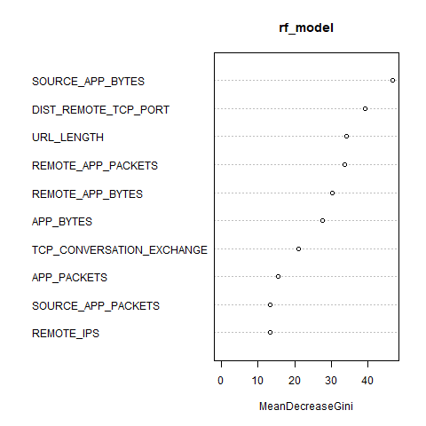
Random Forest
Confusion matrix
Reference
Prediction 0 1
0 420 18
1 9 38
Accuracy :0.9443
The Random Forest model ranked
SOURCE_APP_BYTES as the most
important variable.
Random Forest has the highest accuracy
so it is the best model

